Slide 1
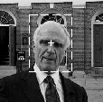
Face Recognition
Shivankush Aras
ArunKumar Subramanian
Zhi Zhang

Slide 2
Overview Of Face Recognition
Face Recognition Technology involves
Analyzing facial Characteristics
Storing features in a database
Using them to identify users
Facial Scan process flow :-
Sample Capture – sensors
Feature Extraction – creation of template
Template Comparison –
* Verification - 1 to 1 comparison
- gives yes/no decision
* Identification - 1 to many comparison
- gives ranked list of matches
4. Matching – Uses different matching algorithms

Slide 3
Technically a three-step procedure :-
Sensor –
* takes observation.
* develops biometric signature.
Eg. Camera.
Normalization –
* same format as signature in database.
* develops normalized signature.
Eg. Shape alignment, intensity correction
Matcher –
* compares normalized signature with the set of normalized signature in system database.
* gives similarity score or distance measure.
Eg. Bayesian technique for matching

Slide 4
Considerations for a potential Face Recognition System
Mode of operation
Size of database for identification or watch list
Demographics of anticipated users.
Lighting conditions.
System installed overtly or covertly
User behavior
How long since last image enrolled
Required throughput rate
Minimum accuracy requirements

Slide 5
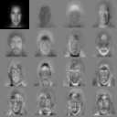
Primary Facial Scan Technologies
1. Eigenfaces – “one’s own face”
* Utilizes the two dimensional global grayscale images representing distinctive characteristics.
2. Feature Analysis –
* accommodates changes in appearance or facial aspect.
3. Neural Networks –
* features from enrollment and verification face vote on match.
4. Automatic Face Processing –
* uses distance and distance ratios
* used in dimly lit, frontal image capture.

Slide 6
Sensors
Used for image capture
Standard off-the-shelf PC cameras, webcams.
Requirements:
* Sufficient processor speed (main factor)
* Adequate Video card.
* 320 X 240 resolution.
* 3-5 frames per second.
( more frames per second and higher resolution lead to a better performance.)
One of the cheaper, inexpensive technologies starting at $ 50.

Slide 7
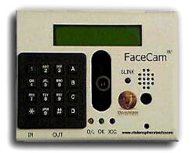
FaceCam
Developed by VisionSphere.
Face recognition technology integrated with speech recognition in one device.
Features
    User-friendly.
    Cost-effective.
    Non-intrusive.
    Auto-enrollment Auto-location of user.
    Voice prompting.
    Immediate user feedback.

Slide 8
Components of FaceCam
Integrated Camera
LCD Display Panel
Alpha-Numeric keypad
Speaker, Microphone
Attached to Pentium II class IBM compatible PC (containing an NTSC capture card and VisionSphere’s face recognition software)
Advantages of FaceCam
Liveness test is performed.
False Accept rate and False Reject Rate is approximately 1%.
Other sensors
A4Vision technology-uses structured light in near-infrared range.
PaPeRo (NEC’s Partner-type Personal Robot)

Slide 9
Feature Extraction
Dimensionality Reduction Transforms
    Karhunen-Loeve Transform/Expansion
    Principal Component Analysis
    Singular Value Decomposition
    Linear Discriminant Analysis
    Fisher Discriminant Analysis
    Independent Discriminant analysis
Discrete Cosine transform
Gabor Wavelet
Spectrofaces
Fractal image coding

Slide 10
Dimensionality Reduction Transforms
Karhunuen-Loeve Transform
  The KL Transform operates a dimensionality reduction on the basis of a statistical analysis of the set of images from their covariance matrix.
  Eigenvectors and the EigenValues of the covariance matrix are calculated and only only the eigenvectors corresponding to the largest eigenvalues are retained i.e. those in which the images present the higher variance.
  Once the Eigenvectors (referred to as eigenpictures) are obtained, any image can be approximately reconstructed using a weighted combination of eigenpictures.
  The higher the number of eigenpictures, the more accurate is the approximation of face images.

Slide 11
Principal Component Analysis
  Each spectrum in the calibration set would have a different set of scaling constants for each variation since the concentrations of the constituents are all different. Therefore, the fraction of each "spectrum" that must be added to reconstruct the unknown data should be related to the concentration of the constituents
  The "variation spectra" are often called eigenvectors (a.k.a., spectral loadings, loading vectors, principal components or factors), for the methods used to calculate them. The scaling constants used to reconstruct the spectra are generally known as scores. This method of breaking down a set spectroscopic data into its most basic variations is called Principal Components Analysis (PCA).
  PCA breaks apart the spectral data into the most common spectral variations (factors, eigenvectors, loadings) and the corresponding scaling coefficients (scores).

Slide 12
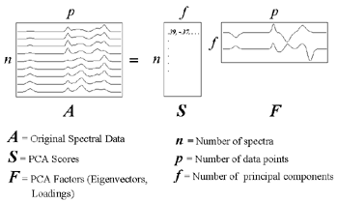

Slide 13
Other Dimensionality reduction transforms
  Factor Analysis is a statistical method for
  modeling the covariance structure of high
  dimensional data using a smal number of latent
  variables, has analogue with PCA.
  LDA/FDA – training carried out via scatter-matrix analysis.
Singular Value Decomposition

Slide 14
Discrete Cosine Transform
DCT is a transform used to compress the representation of the data by discarding redundant information.
Adopted by JPEG
Analogous to Fourier Transform, DCT transforms signals or images from the spatial domain to the frequency domain by means of sinusoidal basis functions, only that DCT adopts real sine functions.
DCT basis are independent on the set of images. DCT is not applied on the entire image, but is taken from square-sampling windows.

Slide 15
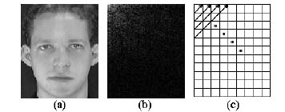
Discrete Cosine Transform

Slide 16
Gabor Wavelet
The preprocessing of images by Gabor wavelets is chosen for its biological relevance and technical properties.
The Gabor wavelets are of similar shape as the receptive fields of simple cells in the primary visual cortex.
They are localized in both space and frequency domains and have the shape of plane waves restricted by a Gaussian envelope function.
Capture properties of spatial localization, orientation selectivity, spatial frequency selectivity and quadrature phase relationship.
A simple model for the responses of simple cells in the primary visual cortex.
It extracts edge and shape information.
It can represent face image in a very compact way.

Slide 17
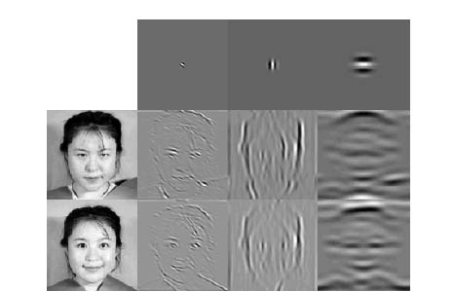
Gabor Wavelet

Slide 18

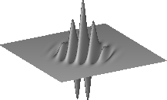
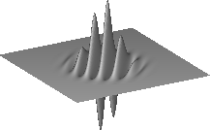
Gabor Wavelet
Real Part
Imaginary Part

Slide 19
Gabor Wavelet
Advantages:
  Fast
  Acceptable accuracy
  Small training set
Disadvantages:
  Affected by complex background
  Slightly rotation invariance

Slide 20
SpectroFace
Face representation method using wavelet transform and Fourier Transform and has been proved to be invariant to translation, on-the-plane rotation and scale.
    First order
    Second order
The first order spectroface extracts features, which are translation invariant and insensitive to facial expressions, small occlusions and minor pose changes.
Second order spectroface extracts features that are invariant to on-the-plane rotation and scale.

Slide 21
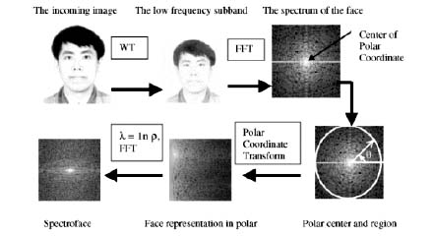
SpectroFace

Slide 22
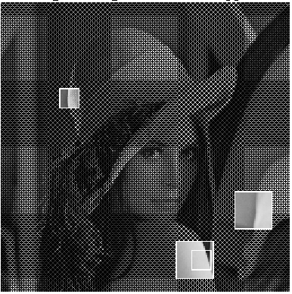
Fractal image Coding
An arbitrary image is encoded into a set of transformations, usually affine. In order to obtain a fractal model of a face image, the image is partitioned into non-overlapping smaller blocks (range) and overlapping blocks (domain). A domain pool is prepared from the available domain blocks. For each range block, a search is done through the domain pool to find a domain block whose contactive information best approximates the range block. A distance metric such as RMS can find the approximation error.

Slide 23
Fractal Image Coding
Main Characteristic
    Relies on the assumption that image redundancy can be efficiently captured and exploited through piecewise self-transformability on a block-wise basis, and that it approximates an original image with the fractal image, obtained from a finite number of iterations of an image transformation called fractal code.

Slide 24
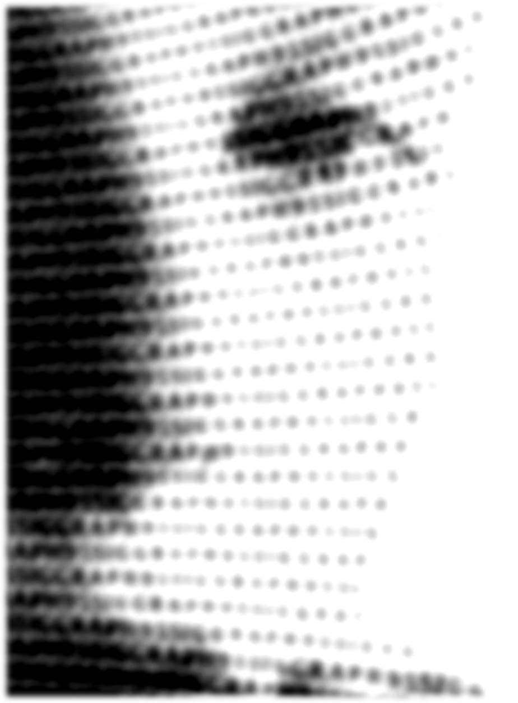
Data Acquisition problems
Illumination
Pose Variation
Emotion

Slide 25
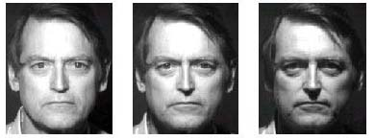
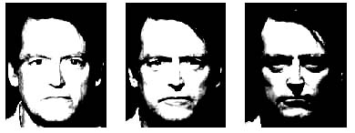
Illumination problem in face recognition
Variability in Illumination
Contrast Model

Slide 26
Approaches to counter illumination problem
Heuristic Approaches
    Discards the three most significant components
    Assumes that the first few principal components capture only variation in lighting
Image Comparison Approaches
    Uses image representations such as edge maps, derivatives of graylevel, images filtered with 2D gabor like functions and a representation that combines a log function of the intensity to these representations.
    Based on the observation that the difference between the two images of the same object is smaller than the difference between images of different objects.
    Extracts Distance measures such as
        Point wise distance
        Regional distance
        Affine-GL distance
        Local Affine-GL distance
        Log pointwise distance

Slide 27
Class-based Approaches
    Requires three aligned training images acquired under different lighting conditions.
    Kohonen’s SOM
    Assumes that faces of different individuals have the same shape and different textures.
    Advantageous as it uses a small set of images.
3D-Model based Approaches
    An eigenhead approximation of a 3D head was obtained after training on about 300 laser-scanned range images of real human heads.
    Transforms shape-from-shading problem to a parametric problem
    An alternative – Symmetric SFS which allows theoretically pointwise 3D information about a symmetric object, to be uniquely recovered from a 2D iaage.
    Based on the observation that all the faces have the similar 3D shape.

Slide 28
Pose Problem in Face Recognition
Performance of biometric systems drops significantly when pose variations are present in the image.
Rotation problem
Methods of handling the rotation problem
    Multi-image based approaches
        Multiple images of each person is used
    Hybrid Approaches
        Multiple images are used during training, but only one database image per person is used during recognition
    Single Image based approaches
        No pose training is carried out

Slide 29
Multi-Image based approaches
Uses a Template-base correlation matching scheme.
For each hypothesized pose, the input image is aligned to database images corresponding to that pose.
The alignment is carried out via a 2D affine transformation based on three key feature points
Finally, correlation scores of all pairs of matching templates are used for recognition.
Limitations
    Many different views per person are needed in the database
    No lighting variations or facial expressions are allowed
    High computational cost due to iterative searching.

Slide 30
Hybrid Approaches
Most successful and practical
Make use of prior class information
Methods
    Linear class-based method
    Graph-matching based method
    View-based eigenface method

Slide 31
Single-Image Based Approaches
Includes
    Low-level feature-based methods
    Invariant feature based methods
    3D model based methods

Slide 32
Matching Schemes
Nearest Neighbor
Neural Networks
Deformable Models
Hidden Markov Models
Support Vector Machines

Slide 33
Nearest Neighbor
A naïve Nearest Neighbor classifier is usually employed in the approaches that adopt a dimensionality reduction technique.
Extract the most representative/discriminant features by projecting the images of the training set in an appropriate subspace of the original space
Represent each training image as a vector of weights obtained by the projection operation
Represent the test image also by the vectors of weights, then compare these vectors to the training images in the reduced space to determine which class it belongs

Slide 34
Neural Networks
A NN approach to Gender Classification:
Using vectors of numerical attributes, such as eyebrow thickness, widths of nose and mouth, chin radius, etc
Two HyperBF networks were trained for each gender
By extending feature vectors, and training one HyperBF for each person, this system can be extended to perform face recognition
A fully automatic face recognition system based on Probabilistic Decision-Based NN (PDBNN):
A hierarchical modular structure
DBNN and LUGS learning

Slide 35
Neural Networks - Cont
A hybrid NN solution
Combining local image sampling, a Self-Organizing Map (SOM) NN and a convolutional NN
SOM provides quantization of the image samples into a topological space where nearby inputs in the original space are also nearby, thereby providing dimensionality reduction and invariance to minor changes in the image sample
Convolutional NN provides for partial invariance to translation, rotation, scale, and deformation

Slide 36
Neural Networks - Cont
A system based on Dynamic Link Architecture (DLA)
DLAs use synaptic plasticity and are able to instantly form sets of neurons grouped into structured graphs and maintain the advantages of neural systems
Gabor based wavelets for the features are used
The structure of signal is determined by 3 factors: input image, random spontaneous excitation of the neurons, and interaction with the cells of the same or neighboring nodes
Binding between neurons is encoded in the form of temporal correlation and is induced by the excitatory connections within the image

Slide 37
Deformable Models
Templates are allowed to translate, rotate and deform to fit the best representation of the shape present in image
Employ wavelet decomposition of the face image as key element of matching pursuit filters to find the subtle differences between faces
Elastic graph approach, based on the discrete wavelet transform: a set of Gabor wavelets is applied at a set of hand-selected prominent object points, so that each point is represented by a set of filter responses, named as a Jet

Slide 38
Hidden Markov Models
Many variations of HMM have been introduced for face recognition problem:
Luminance-based 1D-HMM
DCT-based 1D-HMM
2D Pseudo HMM
Embedded HMM
Low-Complexity 2D HMM
Hybrid HMM
Observable features of these systems are either raw values of the pixels in the scanning element or transformation of these values

Slide 39
Support Vector Machines
Being maximum margin classifiers, SVM are designed to solve two-class problems, while face recognition is a q-classes problem, q = number of known individuals
Two approaches:
Reformulate the face recognition problem as a two-class problem
Employ a set of SVMs to solve a generic q-classes recognition problem

Slide 40
Advantages of Face Recognition Systems
Non-intrusive –
Other biometrics require subject co-operation and awareness.
eg. Iris recognition –looking into eye scanner
Placing hand on fingerprint reader
Biometric data readable and can be verified by a human.
No association with crime.

Slide 41
Applications for Face Recognition Technology
Government Use
      Law Enforcement
      Counter Terrorism
      Immigration
      Legislature
Commercial Use
      Day Care
      Gaming Industry
      Residential Security
      E-Commerce
      Voter Verification
      Banking

Slide 42
State of the art
Three protocols for system evaluation are FERET, XM2VTS and FVRT
Commercial applications of FRT include face verification based ATM and access control and Law enforcement applications include video surveillance.
Both global (based on KL expansion) and local (domain knowledge –face shape, eyes, nose etc.) face descriptors are useful.
Open Research Problems
No general solutions for variations in face images like illumination and pose problems.
Problem of aging ???

